Slide 1
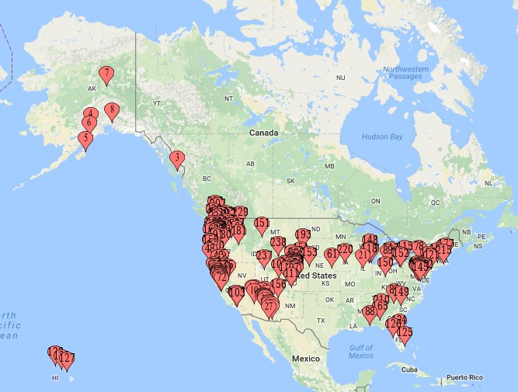
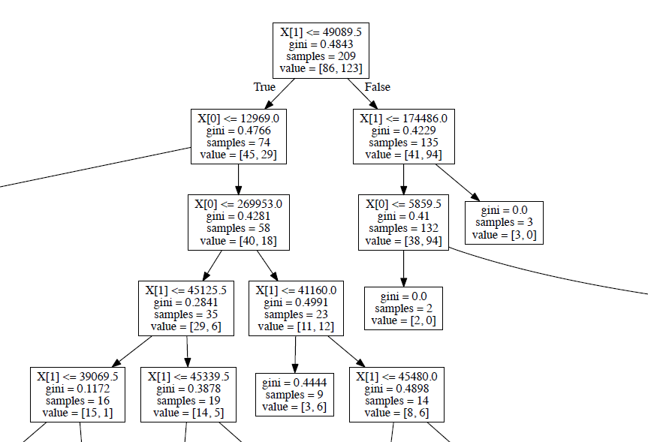



Spring 2017 | DATA MINING | UWYO
Limitations & Challenges
Determining External Factors Responsible for High Risk Cashiers in A Safeway Store
Missing data, The given Safeway Risk Report data has some dirty data, where we did not find address for few store numbers.
IP address was blocked
Could not be able to retrieve the salary information
Cashier information (such as salary, experience) was not provided
Krishnamoorthy, Bopparaju & Midha
Emails: kkrishna@uwyo.edu, sboppara@uwyo.edu & umidha@uwyo.edu
Results
Motivation/Abstract
In this project, we intend to determine external factors that may control the risk factor of the cashier in the Safeway store. The given Safeway cashier risk report identifies the risky cashiers based on the factors such as total number of transactions, coupon usages, refunds, item voids count, base average bag size etc. And here we try to identify external factors (if any) which may determine or identify the risky cashier. We observed the Safeway cashier report carefully and then it was assessed that few stores have high number of risky cashiers. We considered and researched the external factors such as the population of the city, house hold income of the city and the cashier’s salary, which may influence or control the risk factor of the cashier. We collected the city data by the web scraping, cashier’s salary using the Indeed API and analyzed the collected data using the decision tree. This would be helpful for Safeway to identify high risk stores (stores having more number of high risk cashiers) depending upon the above mentioned external factors.
Fig 1. Cities having Safeway Store
Fig 2. Household Income Vs Population
Background
The given Safeway Risk Factor Report identifies the risky cashier based on many factors such as Avg. basket size, Total no. of transactions, Total items count, Coupons etc. And we thought that there may be other factors (such population, household income) which may control the risk factor of a cashier in the Safeway store. In this way, it would be helpful for the Safeway to identify high risky stores. In our project we implemented two methodologies such as Web Scraping and Decision Tree. Using the Web Scraping technique, we have collected the data such as the Store Numbers and their addresses, Population of the city where the store is located, Household income of that city, Avg. Cahier salary and then analyzed the above collected data using the decision trees.
Fig 3. Case 1 Training Data
Fig 4. Case 1 Test Data
Case No. | Accuracy
Case 1 | 0.449367
Case 2 | 0.625899
Case 3 | 0.604316
Project Summary & Major Tasks
Our project was to determine the external factors such as population, household income which may control the risk factor of a cashier
Step 1: From the given Cashier Risk Report: Grouping Safeway stores in to categories:
Step 2: Identify the location of each store. (Store number is given in the report)
Step 3: Obtaining information about the city or area of location.
Step 4: Identify relations between the external factors and the no. of risk cashiers in a store.
Step 5: Check the findings on the test data
How data is collected?
Using Web Scraping
How collected data is analyzed?
Using Decision Tree
Table 1. Results obtained for all the cases
Stores are divided in to categories based on no. of risky cashiers.
The data is divided into 2 parts. 60% of the data in each class was used as a training data to train the decision tree
Fig 5. Part of Case 1 Decision Tree
Future Work & Conclusions
Future Work:
1)Improved data set: Missing data and lack of training data.
2)Pruning of Decision Tree: we used Scikit learn Decision Tree module. This module didn’t have the pruning capability.
3)Adding additional external factors: Income, Age, Experience, Training score etc.
Conclusion:
Test data is almost behaving like trained data.
We got accuracy around 62 % so we can say that these external factors also determine the risk factor of the cashier.
[1] Given Safeway Risk Report Data
[2] http://www.local.safeway.com/ (Safeway Store Loacator)
[3] www.city-data.com, Advameg, Inc
[4] Rokach, Lior, and Oded Maimon. ”Decision trees.” Data Mining and Knowledge Discovery Handbook.
[5] https://www.analyticsvidhya.com/blog/2015/10/beginner-guide-web-scraping-beautiful-soup-python/
[6] https://en.wikipedia.org/wiki/Web_scraping
[7] https://en.wikipedia.org/wiki/Decision_tree
This poster made possible by:
UWYO College of Engineering & Applied Science, UWYO Computer Science Department, and UWYO CEDAR.

